Slide 1


Noida Institute of Engineering and Technology, Greater Noida
Full-Stack Web Development using Laravel with
Vue.JS
Course Code: ACSE0612
Unit: II
Vue.js Framework & Inertia.js
Rupendra Kr. Kaushik
(Asst. Professor)
CSE Department
Course Details (B. Tech. 6th Sem)

Slide 2

Brief Introduction of Faculty
COURSE | BOARD/UNIVERSITY | YEAR OF PASSING
M.Tech | ITM, AKTU, Lucknow | 2022
B.Tech | PKITM, AKTU, Lucknow | 2014
Automatic Image Captioning Using
Ensemble of Deep Learning Techniques ” has been published in the AIR 2022
Organizing in Motilal Nehru National Institute of Technology Prayagraj.
A Comprehensive Review on Image Captioning Using Deep learning ” has been published in the AIR 2022 Organizing in Motilal Nehru National Institute of Technology Prayagraj.
AREA OF INTEREST
Deep Learning, Web Development and Nural Network

Slide 3
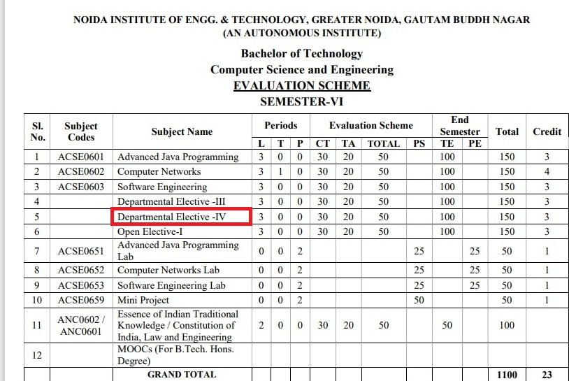
Evaluation Scheme

Slide 4
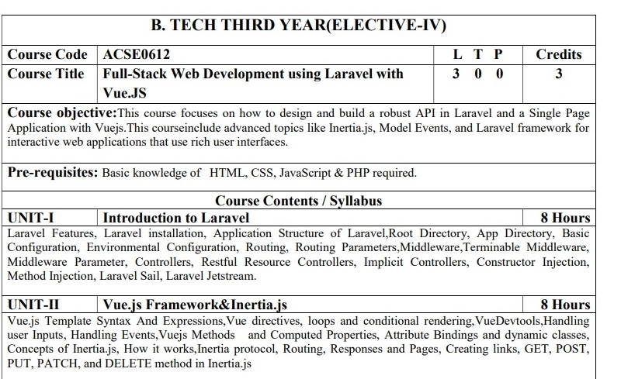
Syllabus

Slide 5
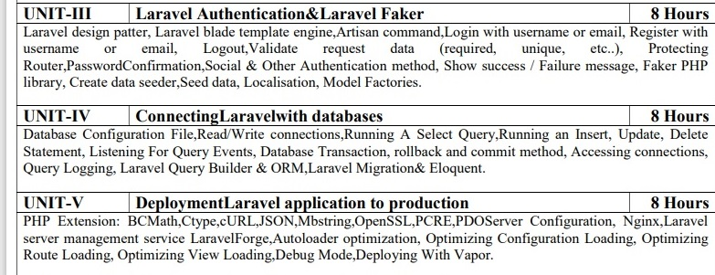
Syllabus (Cont…)

Slide 6
Branch Wise Application
Adaptability: It gives bother free migration, basic, and efficient structure.
Components: They help in creating custom elements that can be reused in HTML.
Transition: Various methodologies are given in Vue.js to apply a transition to HTML components when they are included or expelled from the DOM.
Detailed Documentation: It gives a simple learning curve through point-by-point documentation

Slide 7
Course Objective
1.Laravel Development Means Faster Time-To-Market. ...
2.Better Authentication and Authorization Option. ...
3.Stay Away from Technical Vulnerabilities with Laravel Framework. ...
4.MVC Architecture of Laravel Framework. ...
5.Automated and Unit Testing Feature. ...
6.Automated Task Execution and Scheduling

Slide 8
Course Outcomes (COs)
CO : 01. | Apply the knowledge of PHP that are vital in understanding Laravel application and analyze the concepts, principles and methods in current Server-side technology to implement Laravel application over the web.
CO : 02. | Explain, analyze and apply the role of Client-side scripting language like Vuejs in the workings of the web and web applications.
CO : 03. | Implementing and analyzing the concept of Larvel Faker and Authentication on Laravel.
CO : 04. | Understand the impact of web designing by database connectivity with different databases in the current market place where everyone use to prefer electronic medium for shoping, commerce, and even social life also.
CO : 05. | Analyzing and Creating a functional website using Laravel and Vuejs and Deploying and Optimizing Web Application using Forge / Vapor.

Slide 9
Program Outcomes (POs)
PO : 01. | Engineering Knowledge
PO : 02. | Problem Analysis
PO : 03. | Design/Development of solutions
PO : 04. | Conduct Investigations of complex problems
PO : 05. | Modern tool usage
PO : 06. | The engineer and society
PO : 07. | Environment and sustainability
PO : 08. | Ethics
PO : 09. | Individual and teamwork
PO : 10. | Communication
PO : 11. | Project management and finance
PO : 12. | Life-long learning

Slide 10
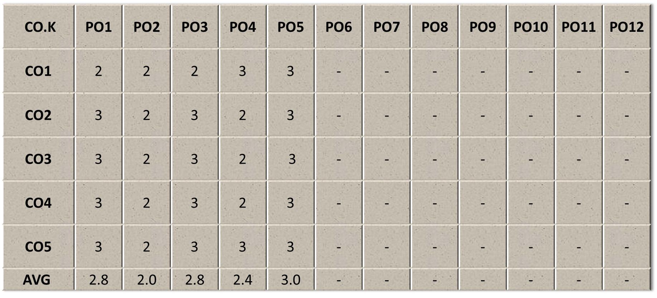
COs - POs Mapping

Slide 11
Program Specific Outcomes(PSOs)
Sr. No. | PSO Description
PSO1 | The ability to identify, analyze real world problems and design their ethical solutions using artificial intelligence, robotics, virtual/augmented reality, data analytics, block chain technology, and cloud computing.
PSO2 | The ability to design and develop the hardware sensor devices and related interfacing software systems for solving complex engineering problems.
PSO3 | The ability to understand inter-disciplinary computing techniques and to apply them in the design of advanced computing.
PSO4 | The ability to conduct investigation of complex problems with the help of technical, managerial, leadership qualities, and modern engineering tools provided by industry-sponsored laboratories.

Slide 12
COs - PSOs Mapping
CO.K | PSO1 | PSO2 | PSO3 | PSO4
CO1 | 3 | - | - | -
CO2 | 3 | 3 | - | -
CO3 | 3 | 3 | - | -
CO4 | 3 | 3 | - | -
CO5 | 3 | 3 | - | -

Slide 13
Program Educational Objectives (PEOs)
Sr. No. | PEOs Description
PEO 1 | To have an excellent scientific and engineering breadth so as to comprehend, analyze, design and provide sustainable solutions for real-life problems using state-of-the-art technologies.
PEO 2 | To have a successful career in industries, to pursue higher studies or to support entrepreneurial endeavors and to face the global challenges.
PEO3 | To have an effective communication skills, professional attitude, ethical values and a desire to learn specific knowledge in emerging trends, technologies for research, innovation and product development and contribution to society.
PEO4 | To have life-long learning for up-skilling and re-skilling for successful professional career as engineer, scientist, entrepreneur and bureaucrat for betterment of society.

Slide 14
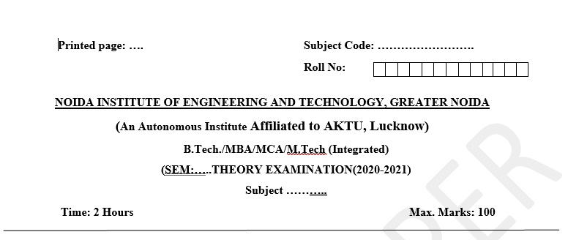
Pattern of External Exam Question Paper (100 marks)

Slide 15
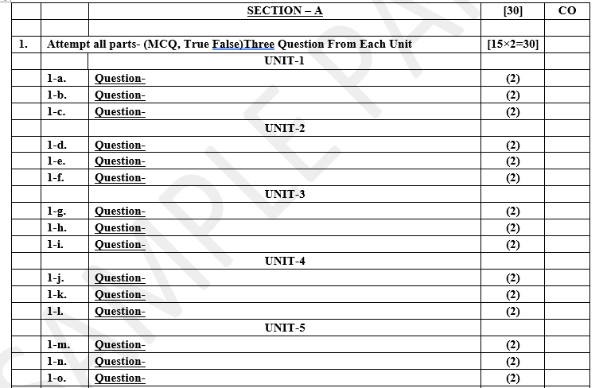
Pattern of External Exam Question Paper (100 marks)

Slide 16
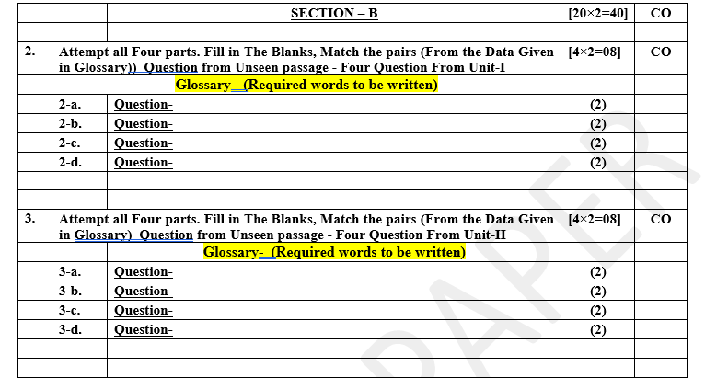
Pattern of External Exam Question Paper (100 marks)

Slide 17
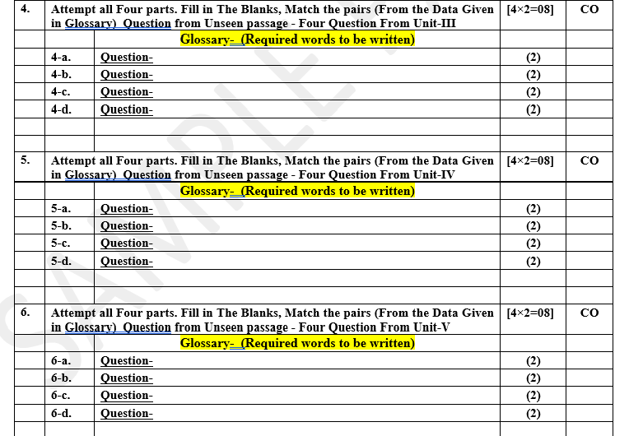
Pattern of External Exam Question Paper (100 marks)

Slide 18
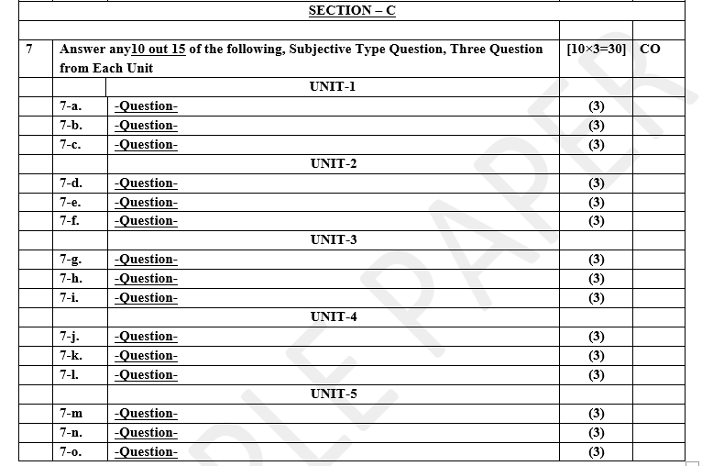
Pattern of External Exam Question Paper (100 marks)

Slide 19

Result Analysis
Branch | Result
CSE | 100%
IT | 98%

Slide 20
Prerequisite / Recap
Before begin progressing with this tutorial, We assume that we are familiar with website development using PHP and MySQL. Also we should be familiar knowledge of HTML, Core PHP, Java script And Advance PHP .
We have applied laravel version 5.1 in all the examples.

Slide 21
Brief Introduction about the Subject with videos
https://www.youtube.com/watch?v=DJ6PD_jBtU0&t=9s
https://www.youtube.com/watch?v=i-TqW5SrizU
https://www.youtube.com/watch?v=VpB0eVZir8U
https://www.youtube.com/watch?v=aQtRuyvY6EQ
https://www.youtube.com/watch?v=aQtRuyvY6EQ

Slide 22
Unit content
Vue.js Template Syntax And Expressions
Vue directives
loops and conditional rendering
VueDevtools,Handling user Inputs
Handling Events
Vuejs Methods and Computed Properties
Attribute Bindings and dynamic classes
Concepts of Inertia.js
How it works
Inertia protocol
Routing
Responses and Pages
Creating links, GET, POST, PUT, PATCH, and DELETE method in Inertia.js

Slide 23
Unit Objective
In Unit II, the students will be able to find
Definitions of terms and concepts.
How VueJS is primarily used to build web interfaces and one-page applications.
The idea of a Vue.js Framework
Design web applications
Scope of development activity: applications, toolkits, frameworks.

Slide 24
Topic Objective
Virtual DOM. VueJS makes the use of virtual DOM, which is also used by other frameworks such as React, Ember, etc. ...
Data Binding. ...
Components. ...
Event Handling. ...
Animation/Transition. ...
Computed Properties. ...
Templates. ...
Directives

Slide 25
Vue.js Template Syntax
In this chapter, we will learn how to get an output in the form of an HTML template on the screen.
Vue.js uses an HTML-based template syntax that facilitates Vue.js developers to declaratively bind the rendered DOM to the underlying Vue instance's data.
All Vue.js templates are valid HTML that can be parsed by spec-compliant browsers and HTML parsers.
If you choose the simple interpolation method i.e., with double curly brackets to display the HTML content on the web browser, it will show the wrong result.

Slide 26
Vue.js Template Syntax(Cont..)
Index.html file:
<html>
<head>
<title>Vue.js Template</title>
<link rel="stylesheet" href="index.css">
<script src="https://cdn.jsdelivr.net/npm/vue/dist/vue.js"></script>
</head>
<body>
<div id = "app">
<h1>Firstname : {{firstname}}</h1>
<h1>Lastname : {{lastname}}</h1>
<div>{{htmlcontent}}</div>
</div>
<script src="index.js"></script>
</body>
</html>

Slide 27
Vue.js Template Syntax(Cont..)
Index.js file
var vm = new Vue({
el: '#app',
data: {
firstname : "Albert",
lastname : "Pinto",
htmlcontent : "<div><h1>This is Vue.js Template Example</h1></div>"
}
})
Let's use a simple CSS file to make the output more attractive
Index.css file:
html, body {
margin: 5px;
padding: 0;
}

Slide 28
Vue.js Expressions
Vue.js does not only provide features for binding a variable. Vue.js can be used to write various types of expressions within double curly braces.
{{ count + 1 }}
{{ check ? "true" : "False" }}
{{ arr.sort().reverse() }}

Slide 29
Vue directives
Directives are used to modify the behavior of our HTML elements which reside in the DOM.
In other words, we can say that directives are one of the important parts of the Vue and it is used just like an HTML element’s attribute added along with any HTML elements into the Vue template.
This is called the special attribute by which we can perform the various kind of actions based on the directive function implementation.
The Vue.js Directives are one of the special versions of HTML attributes that allow us to manipulate the DOM elements based on the multiple parameter or conditions. Directives are very powerful and they can be used for day-to-day development activities like hiding/show elements, adding/removing elements, and so on

Slide 30
Syntax to use Directives in Vuejs
In order to create and use the different directives, for that, we need to follow the directive pattern which is explained below. In Vue, we need to use the “v-” prefix along with the directive name as given in the below example.
<element prefix-directiveId="[arg:] ( keypath | expression ) [filters...]">
// code
</element>
As you can see in the above syntax, we have a “prefix” followed by the directive name or id which we can use to identify the type of directive, below is a simple example of the v-model directive which is an in-built directive provided with the Vue.

Slide 31
Types of Directives in Vue
we have learned what is directive and how to use any of the types of directives in our Vue application. Vuejs contains a number of different directives, which we can use to perform various actions based on different situations. Below are the different directives supported into the Vue along with the appropriate examples.
v-show directive
The v-show directive in Vuejs is used to show or hide the different HTML elements conditionally. Just like the toggle effect, if we want to hide or show something based on the specific flag, then we can use this directive in order to achieve the hide/show function.
The v-show directive is similar to the if-else condition where if the condition is fulfilled then show perform some action, and if not then any default action can happen.
Syntax
<element v-show="flag/condition">
// content
</element>

Slide 32
Vue.js Conditions & Loops
Conditions and Loops are used in all programming languages to provide repetitive control structures.
They can repeat one or more various steps depending on the conditions. Same we can use in the case of Vue.js.
In React, you can create distinct components that encapsulate behavior you need.
Then, you can render only some of them, depending on the state of your application. Conditional rendering in React works the same way conditions work in JavaScript.

Slide 33
v-if Directive Example
Index.html file:
1. <html>
2. <head>
3. <link rel="stylesheet" href="index.css">
4. <script src="https://cdn.jsdelivr.net/npm/vue/dist/vue.js"></script>
5. </head>
6. <body>
7. <div id="app">
8. <span v-if="seen">This is visible to you</span>
9. </div>
10. <script src="index.js"></script>
11. </body>
12. </html>
Index.js file:
1. var app = new Vue({
2. el: '#app',
3. data: {
4. seen: true
5. }
6. })

Slide 34
v-if Directive Example(Cont…)

Slide 35
v- else-if Directive Example
We can use the v- else-if directive to provide an else functionality in the above example. By using this directive, if the condition is not satisfied or not true then it will return the else statement that you set for the program. Let's see an example.
Index.html file:
1. <html>
2. <head>
3. <link rel="stylesheet" href="index.css">
4. <script src="https://cdn.jsdelivr.net/npm/vue/dist/vue.js"></script>
5. </head>
6. <body>
7. <div id="app">
8. <span v-if="seen">Now you see me</span>
9. <span v-else-if=>You can't see me </span>
10. </div>
11. <script src="index.js"></script>
12. </body>
13. </html>

Slide 36
v- else-if Directive Example(Cont…)
Index.js file:
1. var app = new Vue({
2. el: '#app',
3. data: {
4. seen: false
5. }
6. })

Slide 37
v- for Directive Example
The v-for directive is used to display a list of items using the data from an Array. See the following example
Index.html file:
1. <html>
2. <head>
3. <link rel="stylesheet" href="index.css">
4. <script src="https://cdn.jsdelivr.net/npm/vue/dist/vue.js"></script>
5. </head>
6. <body>
7. <div id="app-4">
8. <ol>
9. <li v-for="todo in todos">
10. {{ todo.text }}
11. </li>
12. </ol>
13. </div>
14. <script src="index.js"></script>
15. </body>
16. </html>

Slide 38
v- for Directive Example(Cont…)
Index.js file:
1. var app4 = new Vue({
2. el: '#app-4',
3. data: {
4. todos: [
5. { text: 'HTML Tutorial' },
6. { text: 'CSS Tutorial' },
7. { text: 'JavaScript Tutorial' },
8. { text: 'AngularJS Tutorial' },
9. { text: 'Vue.js Tutorial' }
10. ]
11. }
12. })

Slide 39
Vue Devtools
Vue Devtools is a browser extension that can assist you in the development of a
Vue.js project.
Among other things, it allows you to see the hierarchy of
components in your app and the state of components, which is useful for
debugging:

Slide 40
Handling User Input
The v-on directive facilitates users to interact with your Vue.js app. It is used to attach event listeners that invoke methods on Vue instances. Let's see an example of v-on directive.
v-on Directive Example
Index.html file:
1. <html>
2. <head>
3. <link rel="stylesheet" href="index.css">
4. <script src="https://cdn.jsdelivr.net/npm/vue/dist/vue.js"></script>
5. </head>
6. <body>
7. <div id="app">
8. <p>{{ message }}</p>
9. <button v-on:click="reverseMessage">Click Here to Reverse Message</button>
10. </div>
11. <script src="index.js"></script>
</body>
</html>

Slide 41
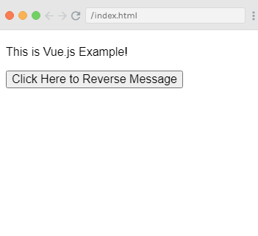
Handling User Input(Cont..)
Index.js file:
1. var app = new Vue({
2. el: '#app',
3. data: {
4. message: 'This is Vue.js Example!'
5. },
6. methods: {
7. reverseMessage: function () {
8. thisthis.message = this.message.split('').reverse().join('')
9. }
10. }
11. })
Output:
After clicking on the "Click Here to Reverse Message" button, the above string will be reversed.

Slide 42
Handling User Input(Cont..)
v-model Directive Example
The v-model directive is used to make two-way data binding between form input and app state. See the following example:
Index.html file:
1. <html>
2. <head>
3. <link rel="stylesheet" href="index.css">
4. <script src="https://cdn.jsdelivr.net/npm/vue/dist/vue.js"></script>
5. </head>
6. <body>
7. <div id="app">
8. <p>{{ message }}</p>
9. <input v-model="message">
10. </div>
11. <script src="index.js"></script>
12. </body>
13. </html>

Slide 43
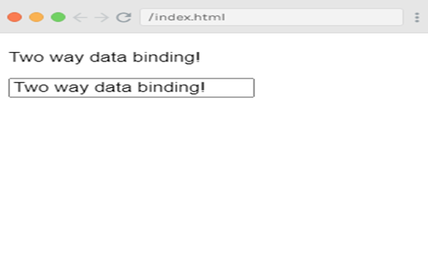
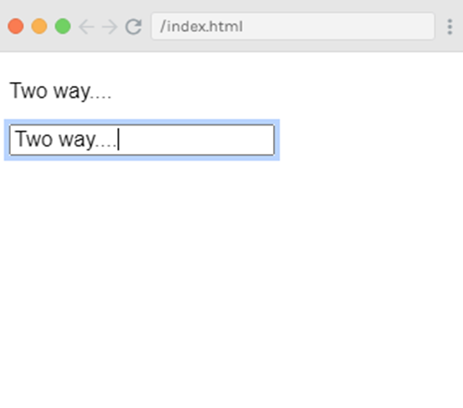
Handling User Input(Cont..)
Index.js file:
1. var app6 = new Vue({
2. el: '#app',
3. data: {
4. message: 'Two way data binding!'
5. }
6. })
Output:
You will see the automatic synchronization of data in the above example. When you change the data in one component, the change will be reflected in both components.

Slide 44
Vue.js Events
In Vue.js, Events are used to respond to an action. Suppose, you have to build a dynamic website using Vue.js then you'll most likely want it to be able to respond to events.
For example, if your Vue.js website has clickable buttons, forms, etc., you would surely want that if a user clicks a buttoVue.js Event Handling
n, submits a form, or even moves their mouse Vue.js website would respond somehow
Vue.js Event Handling
To handle an event with Vue.js
we have to add the v-on directive to the relevant DOM element. For example, if you want to handle a click on a button element then you should add the following code to your Vue template:

Slide 45
Types of Vue.js events that you can handle
You can handle a lot of other Vue.js DOM events besides click. Vue.js can handle any kind of web or mobile native events as well as custom events. The most common events that are generally used to be handled:
o submit
o keyup
o drag
o scroll
o error
o abort
o mouseover
o mouseout
o load etc.

Slide 46
Event Handling Methods
Click Event
See the following example to demonstrate the click event handling in Vue.js.
Index.html file:
1. <html>
2. <head>
3. <title>Vue.js Event Handling</title>
4. <link rel="stylesheet" href="index.css">
5. <script src="https://cdn.jsdelivr.net/npm/vue/dist/vue.js"></script>
6. </head>
7. <body>
8. <div id="app">
9. <button v-on:click = "displaynumbers">Click Me to Add No.</button>
10. <h2> Add Number 100 + 200 = {{total}}</h2>
11. </div>
12. <script src="index.js"></script>
13. </body>
14. </html>

Slide 47
Event Handling Methods(Cont…)
Index.js file:
1. var vm = new Vue({
2. el: "#app",
3. data: {
4. num1: 50,
5. num2 : 100,
6. total : ''
7. },
8. methods : {
9. displaynumbers : function(event) {
10. console.log(event);
11. return thisthis.total = this.num1+ this.num2;
12. }
13. },
14. })
Let's use a simple CSS file to make the output more attractive.

Slide 48
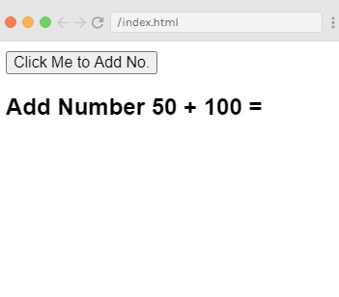
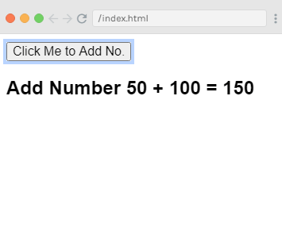
Event Handling Methods(Cont…)
Index.css file:
1. html, body {
2. margin: 5px;
3. padding: 0;
4. }
After the execution of the program, you will see the following output:
Output:
When you click on the above button, you can see that it has added the number.

Slide 49
Vue.js Event Modifiers
Vue.js provides some event modifiers available on v-on attribute. We can very easily call event.preventDefault() or event.stopPropagation() inside event handlers. Here, .prevent and .stop are event modifiers.
These modifiers are directive postfixes denoted by a dot. Following is the list of most common modifiers available on v-on attribute:
o .once
o .prevent
o .stop
o .capture
o .self
o .passive

Slide 50
Concepts of Inertia.js
Inertia is a library that combines the best of both server-side rendering (SSR) and client-side rendering (CSR) by allowing developers to build SPAs using server-side routing and controllers.
Inertia is a new approach to building classic server-driven web apps. We call it the modern monolith. Inertia allows you to create fully client-side rendered, single-page apps, without much of the complexity that comes with modern SPAs. It does this by leveraging existing server-side frameworks

Slide 51
How it works
With Inertia you build apps just like you've always done with your server-side web framework of choice. You use your framework's existing functionality for routing, controllers, middleware, authentication, authorization, data fetching, and more.
The only thing that's different is your view layer. Instead of using server-side rendering (eg. Blade or ERB templates), the views are JavaScript page components. This allows you to build your entire front-end using React, Vue or Svelte
But simply creating your front-end in JavaScript doesn't give you a single-page app experience. If you were to click a link, your browser would make a full page visit, which would then cause your client-side framework to reboot on the subsequent page load. This is where Inertia comes in

Slide 52
Inertia Protocol
HTML responses
Inertia responses
The page object
Asset versioning
Partial reloads

Slide 53
Inertia Protocol(Cont…)
HTML responses
The very first request to an Inertia app is just a regular full-page browser request, with no special Inertia headers or data. For these requests, the server returns a full HTML document.
This HTML response includes the site assets (CSS, JavaScript) as well as a root <div> in the body. The root <div> serves as a mounting point for the client-side app, and includes a data-page attribute with a JSON encoded page object for the initial page. Inertia uses this information to boot your client-side framework, and display the initial page component.
Inertia responses
Once an Inertia app has been booted, all subsequent requests to the site are made via XHR with a special X-Inertia header set to true. This header indicates that the request is being made by Inertia, and isn't a standard full-page visit.
When the server detects the X-Inertia header, instead of responding with a full HTML document, it returns a JSON response with an encoded page object.

Slide 54
Inertia Protocol(Cont…)
The page object
Inertia shares data between the server and client via a page object. This object includes the necessary information required to render the page component, update the history state, and track the site's asset version. The page object includes the following four properties:
component: The name of the JavaScript page component.
props: The page props (data).
url: The page url.
version: The current asset version.
On standard full page visits, the page object is JSON encoded into the data-page attribute in the root <div>. On Inertia visits, the page object is returned as the JSON payload.

Slide 55
Inertia Protocol(Cont…)
Asset versioning
One common challenge with single-page apps is refreshing site assets when they've been changed. Inertia makes this easy by optionally tracking the current version of the site's assets. In the event that an asset changes, Inertia will automatically make a hard (full) page visit instead of an XHR visit.
Included in the page object is a version identifier. This version identifier is set server-side, and can be a number, string, file hash, whatever. It doesn't matter, as long as it changes when the site's assets have been updated.
Whenever an Inertia request is made, Inertia will include the current asset version in the X-Inertia-Version header. When the server receives the request, it compares the asset version provided in the X-Inertia-Version header with the current asset version. This is typically handled in a middleware layer.
Finally, in the event that flash session data exists when a Conflict response occurs, the server will automatically reflash this data

Slide 56
Inertia Protocol(Cont…)
Partial reloads
When making Inertia requests, the partial reloads option allows you to request a subset of the props (data) from the server on subsequent visits to the same page component. This can be a helpful performance optimization if it's acceptable that some page data becomes stale.
When a partial reload request is made, Inertia includes two additional headers with the request: X-Inertia-Partial-Data and X-Inertia-Partial-Component.
The X-Inertia-Partial-Data header is a comma separated list of the desired props (data) keys that should be returned.
The X-Inertia-Partial-Component header includes the name of the component that is being partially reloaded.

Slide 57
Routing
Defining routes
With Inertia all routing is defined server-side. Meaning you don't need Vue Router or React Router. Simply create routes using your server-side framework of choice.
Route::inertia('/about', 'About');
Route helpers
If you have a page that doesn't need a corresponding controller method, like an FAQ or about page, you can route directly to a component
Generating URLs
Some server-side frameworks allow you to generate URLs from named routes. However, you will not have access to those helpers client-side. Here are a couple ways to still use named routes with Inertia.
The first option is to generate URLs server-side and include them as props. Notice in this example how we're passing the edit_url and create_url to the Users/Index component.

Slide 58
Response
Creating responses
In your controller, provide both the name of the JavaScript page component, as well as any props (data) for the page.
we're passing a single prop, called event, which contains four attributes (id, title, start_date and description) to the Event/Show page component

Slide 59
Response(Cont…)
use Inertia\Inertia;
class EventsController extends Controller
{
public function show(Event $event)
{
return Inertia::render('Event/Show', [
'event' => $event->only('id', 'title', 'start_date', 'description'),
]);
// Alternatively, you can use the inertia() helper
return inertia('Event/Show', [
'event' => $event->only('id', 'title', 'start_date', 'description'),
]);
}
}

Slide 60
Pages
With Inertia, each page in your application has its own controller and corresponding JavaScript component. This allows you to retrieve just the data necessary for that page, no API required.
Creating pages
Pages are simply JavaScript components. There is nothing particularly special about them. Pages receive data from the controllers as props. Here's an example of a simple page component.

Slide 61
Pages(Cont…)
<template>
<Layout>
<Head title="Welcome" />
<h1>Welcome</h1>
<p>Hello {{ user.name }}, welcome to your first Inertia app!</p>
</Layout>
</template>
<script>
import Layout from './Layout'
import { Head } from '@inertiajs/inertia-vue3'
export default {
components: {
Head,
Layout,
},
props: {
user: Object,
},
}
</script>

Slide 62
Get Method
The Get Method
Get method is used to retrieve or get the information from the given server using a given URL. In REST CURD, it performs the read operation.
Let’s try GET method :
Let’s set up an HTML file that you can run locally on your browser. Create a file called get.html.Let’s look at the code :

Slide 63
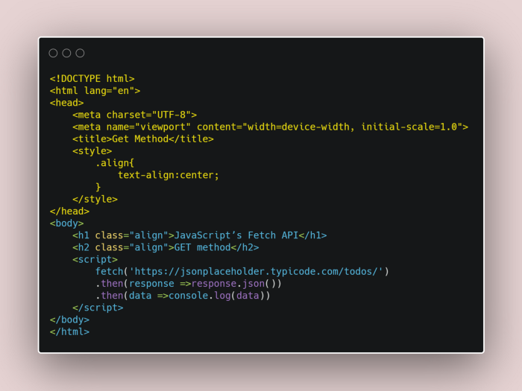
Get Method(Cont…)

Slide 64
Post Method
Post is used for sending data to the server such as uploading a file or transferring some data or adding a new row to the back end table to any kind of web form. In a simple sentence, we can say that the post method is used for inserting new items in the backend server. In REST CRUD operation it performs the create operation.
Let’s try the post method:
Again create a post.html file that can run in your local browser. Let’s try the code:

Slide 65
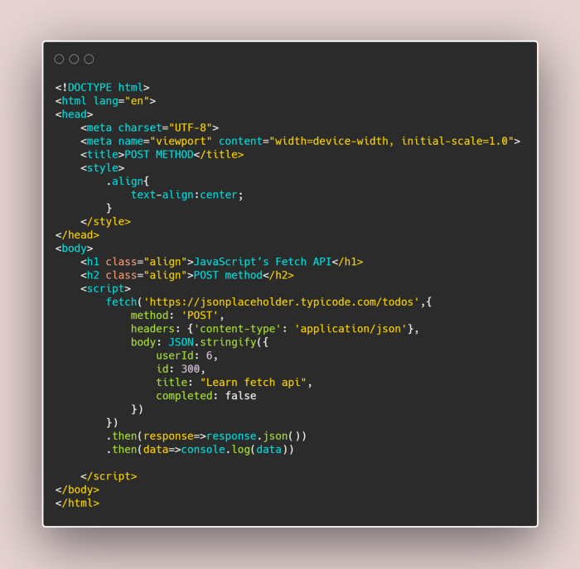
Post Method(Cont…)

Slide 66
PUT Method
The PUT method is most often used to update an existing resource.
PUT method mechanism:
In HTTP.PUT method, the resource is first identified by the URL and if it exists, then it is updated, otherwise, a new resource is created. In simply we can say that If the resource exists then update else create a new resource.
Let’s try to understand the put method through the code

Slide 67
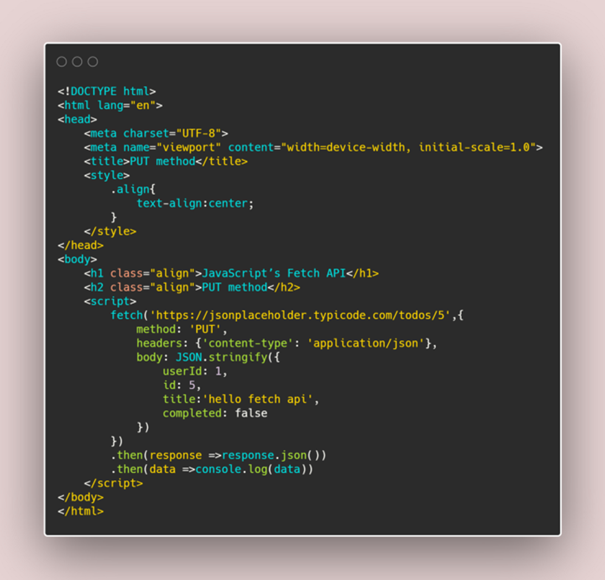
PUT Method(Cont…)

Slide 68
PATCH METHOD
The PATCH method is used to update the values of the resource properties.
let’s look at the patch method
Before writing the code look at the below screenshot which is taken from the placeholder where userID:1 this userID has two property one is the title & another one is the completed. Respectively their values are ‘delectus aut autem’ & ‘false’.Here we are going to update the values of the resource properties.

Slide 69
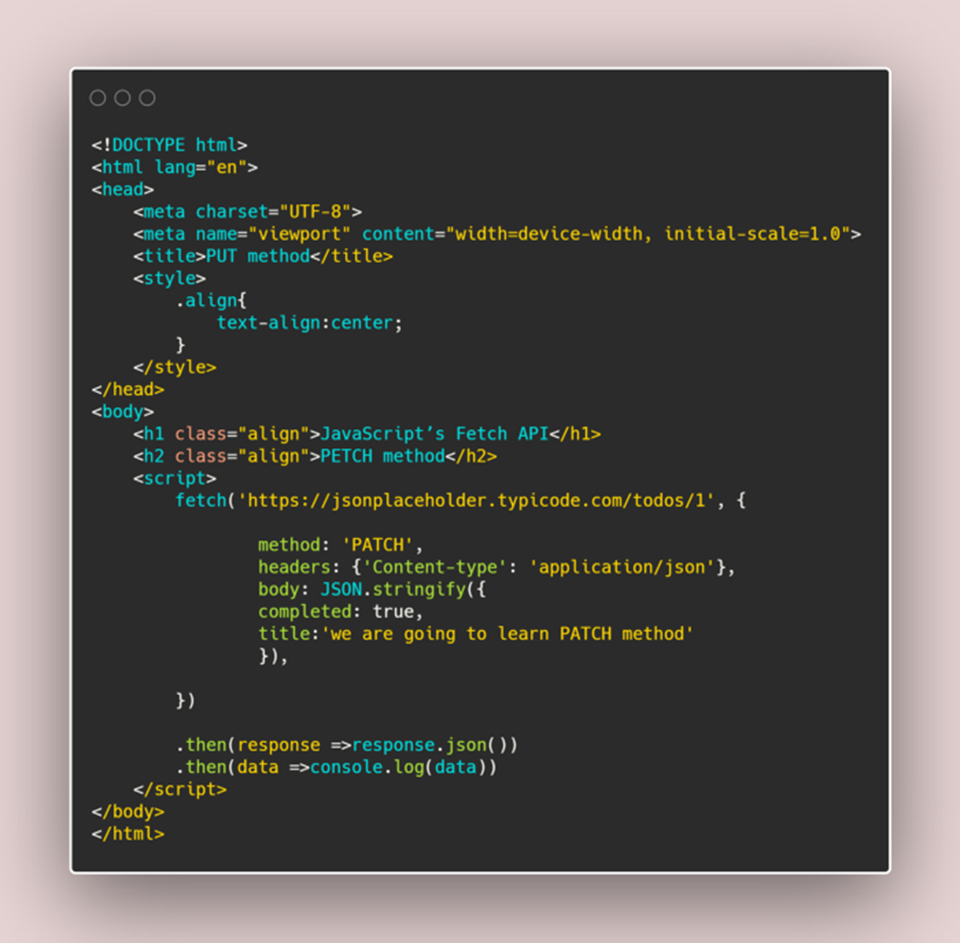
PATCH METHOD(Cont…)

Slide 70
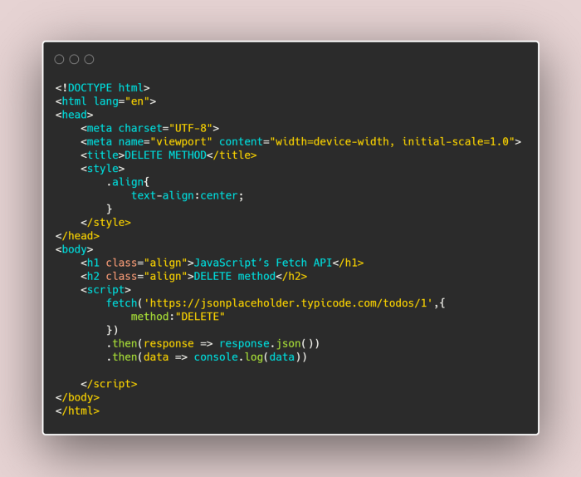
DELETE METHOD
The DELETE method is used to delete a resource specified by its URI

Slide 71
Daily Quiz
1 Following directive is used for one-way data binding in Vue.js
A)v-on
B)v-model
C)no-one
D)v-bind
2 How many ways are there to define a filter in Vue.js?
A)1
B)2
C)3
D)4
3 following is the correct full form of MVVM?
A)Model-Value-Value Model
B)Model-View-Value Model
C)Model-View-View Model
D)Module-View-View Mode

Slide 72
Daily Quiz
4. Following is the correct definition of Vue JS
a) Vue.js is a JavaScript library that makes traversing and administering the HTML DOM tree, event handling, CSS activity, and Ajax easier
b) Vue.js is an open-source JavaScript front-end framework for creating user interfaces
c) Vue.js is a JavaScript library for creating user interfaces that are open-source
d) Vue.js is a cross-platform, open-source JavaScript run-time environment that executes JavaScript code outside of a web browser
5. Vue.JS was created by which of the following companies
a) Facebook
b) Google
c) Microsoft
d) Samsung
6Keyword is used to create a constant in Vue.JS a) constant b) int c) const d) define

Slide 73
Weekly Assignment
1. Create a web page in Vue.js
2. Define different types of Components in Vue.js
3. Discuss the directives in Vue.js, List some of them you used?
4. Explain the differences between one-way data flow and two-way data binding
5. Create Two-Way Bindings in Vue.js
6. Explain the difference between v-show and v-if.
7. Describe the ref in Vue.js.
8.Explain how can I fetch query parameters in Vue.js

Slide 74
Topic Link ( YouTube & NPTEL Video Links)
https://youtu.be/qZXt1Aom3Cs
https://youtu.be/FXpIoQ_rT_c
https://youtu.be/nhBVL41-_Cw
https://youtu.be/bzlFvd0b65c
https://youtu.be/e-E0UB-YDRk

Slide 75
MCQ (End of Unit)
1 _________ is a progressive JavaScript framework used to develop interactive web interfaces.
A. AngularJs B. VueJS C. ReduxJS D. ReactJS
2 VueJS is an open source progressive JavaScript framework used to develop interactive web interfaces.
A. TRUE B. FALSE C. Can be true or false D. Can not say
3 To start with VueJS, we need to create the instance of Vue, which is called the?
A. root Instance B. Vue Instance C. root Vue Instance D. root Vue

Slide 76
MCQ (End of Unit)
4 The following is the correct syntax to use for loop in Vue.js?
A) *v-for
B) vFor
C) v-for
D) None of the above.
5 Following syntax is correct for creating a Vue.js instance?
A) var text = new Vue({// options })
B) var text = new text ({//options})
C) var text = new class ({//options})
D) var text = new object ({//options})
6 The following data binding interpolation is also known as "Mustache" syntax?
A) []
B) {{}}
C) v-on
D) v-model

Slide 77
MCQ (End of Unit)
7 Main usage of Vue.js
A)Vue.js is a dynamic JavaScript framework that is frequently used for developing user interfaces.
B)Vue.js is a JavaScript library that makes user interfaces for single-page applications by dividing UI into components.
C)Vue.js uses the MVVM pattern to bind data to certain DOM elements.
D)All of the above.
8 The following modifier is very useful for improving the performance of mobile devices?
A).directive
B).once
C).capture
D).passive

Slide 78
Glossary Questions
Discuss Vue.js Template Syntax.
Explain Vue directives,
Explain loops and conditional rendering with example,
Discuss Vue Devtools
Define Attribute Bindings
Explain the working of Inertia.js.
Explain GET, POST, PUT, PATCH, and DELETE method in Inertia.js

Slide 79
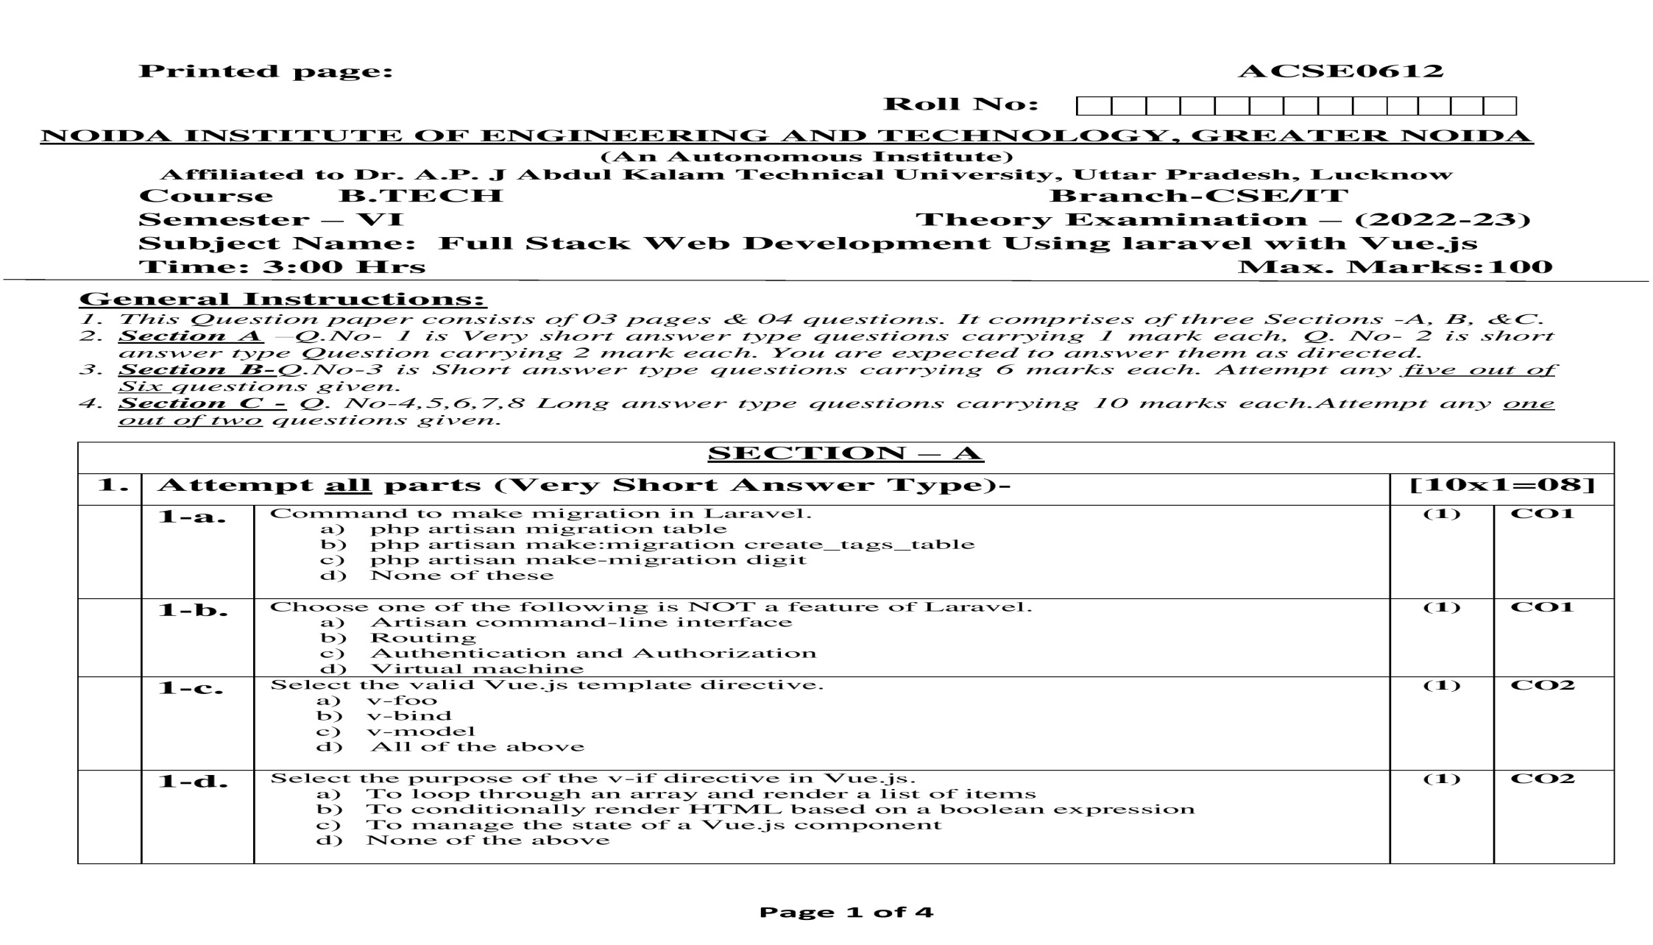
Old Question Paper

Slide 80
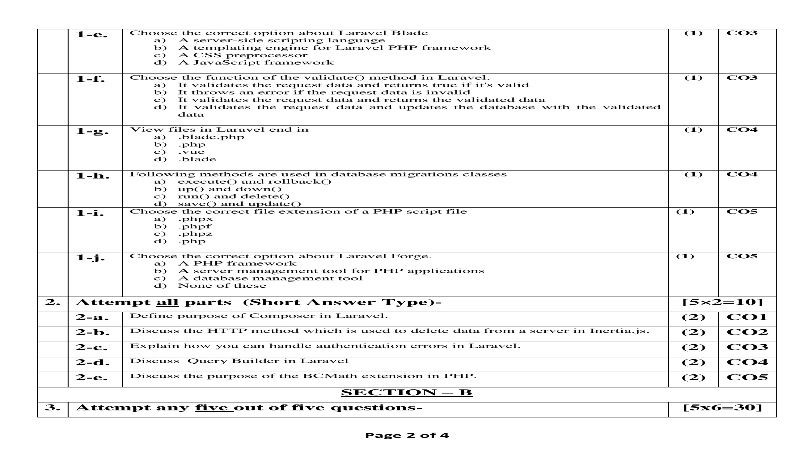
Old Question Paper

Slide 81
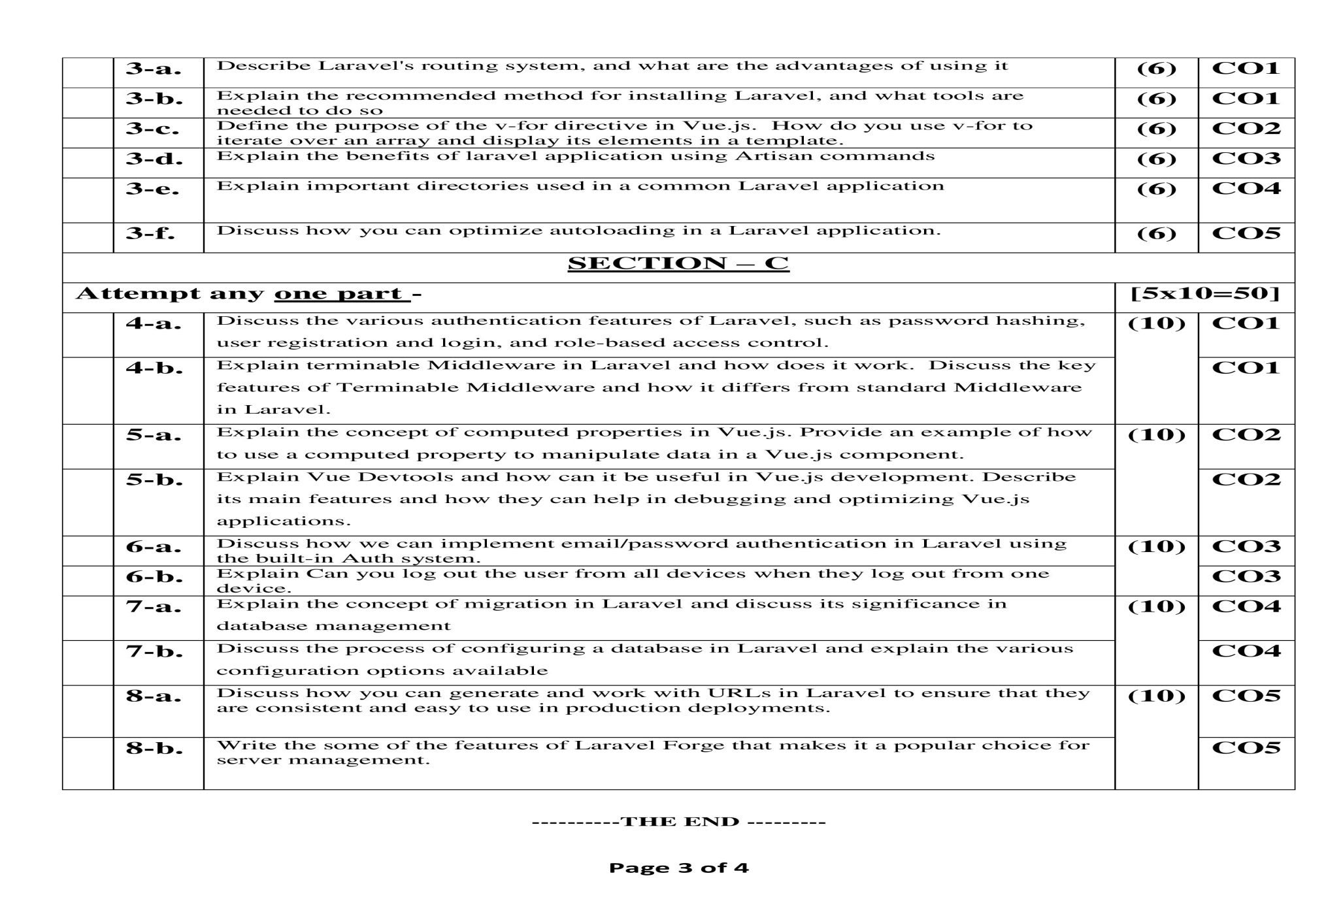
Old Question Paper

Slide 82
Expected Questions for University Exam
Explain why would you choose Vue.js over other front-end frameworks
Define the virtual DOM and how is it beneficial
Show the benefits of using Vue CLI
Discuss instant prototyping, and how does it work
Define the best way to maintain state in an extensive vue application, and why is it recommended
Explain how can the performance of Vue.js be improved

Slide 83
Recap of Unit
Student learnt Vue.js Template Syntax And Expressions
We discussed Vue directives
loops and conditional rendering
Student learnt Handling user Inputs
We explain Concepts of Inertia.js
How GET, POST, PUT, PATCH, and DELETE methods works in Inertia.js

